Slide 1
Data Enrichment Pipeline for JLR
-- Sarang Kulkarni
Senior Data Engineer

Slide 2
Business Problem
Context
JLR sells vehicles with multiple configurable options.
Base sales dataset contains option-level sales transactions by VIN.
Problem
Missing or inconsistent production cost data for options.
Incomplete & poor-quality data makes profitability analysis unreliable.
Objective
Build an automated ETL pipeline.
Enrich sales data using lookup datasets (options cost, vehicle mapping).
Deliver accurate profit per option per vehicle to enable strategic decision-making.

Slide 3

Data Sources & Quality Findings
Base Data : (CSV File provided)
18,363 duplicate rows.
28 null VINs → traceability issue.
24 null Sales Prices → breaks profit calculation.
1,209 distinct option codes detected.
Gap: 913 option codes not found in Options Data.
Options Data : (CSV File provided)
Material Cost has no null values.
478 distinct option codes.
Gap: 182 option codes present here but not in Base Data.
Option Code + Model provides good consistency with Base Data.
Vehicle Line Mapping Data : (CSV File provided)
2 null values each in platform and nameplate display.
Small size may not cover all models in Base Data.

Slide 4
Challenges
Data Quality Issues
Missing Values in Base Data.
Duplicate data in Base Data (~18K rows).
Data Alignment Issues
913 option codes in Base Data not present in Options Data.
182 option codes in Options Data not found in Base Data.
Vehicle Line Mapping (22 rows) may not cover all models.
Business Impact
Incomplete costs can lead to miscalculation of profits.

Slide 5
Enrichment Logic
For enriching the base data, the analyst provided a set of rules. The approach was hence designed as follows.
Zero / Negative Sales Price → Production cost = 0.
Exact Match (Option Code + Model) → Use material cost from Options Data.
No (Option Code + Model) Match → Use average material cost for that Option Code.
No Option Code Found → Estimate cost as 45% of sales price.
Notes:
First check the sales price, if the sales price is zero or negative, then the production cost is set to zero immediately.
If there’s an exact match for option and model in Options Data, then the material cost should be directly used as the production cost.
If there’s no exact match, then the average cost for the option across the models should be used as production cost.
And if the option code in the base data is missing, 45% of sales price would be used as the production cost.

Slide 6
2-Week Sprint Plan – End-to-End Delivery
Week 1 – Analysis & Design
Problem Analysis : Reviewed base, options, and vehicle mapping datasets; identified quality issues (nulls, duplicates, schema mismatches).
System Design : Defined layered architecture (Raw → Transformed → Curated), enrichment logic, orchestration flow.
Planning : Broke work into tasks, defined success KPIs (data accuracy, freshness, cost).
Initial Development : Built ingestion (GCS → BigQuery) and performed EDA/cleaning in Databricks.
Week 2 – Development, Testing & Delivery
Development : Implemented enrichment logic in PySpark (joins, fallback rules, profit calculation).
Testing : Unit tests, Great Expectations checks (row counts, nulls, ranges, profit sanity).
Orchestration : Automated with Airflow/Composer DAG, added retries & alerts.
Documentation : Created runbook, data contracts, pipeline README.
Reporting : Built Power BI dashboard with total profit & profitability insights.
Handover : Presented curated datasets & insights back to stakeholders.
Outcome
Delivered an end-to-end production-ready pipeline within 2 weeks.
Covered full lifecycle: analysis → design → build → test → document → report.

Slide 7
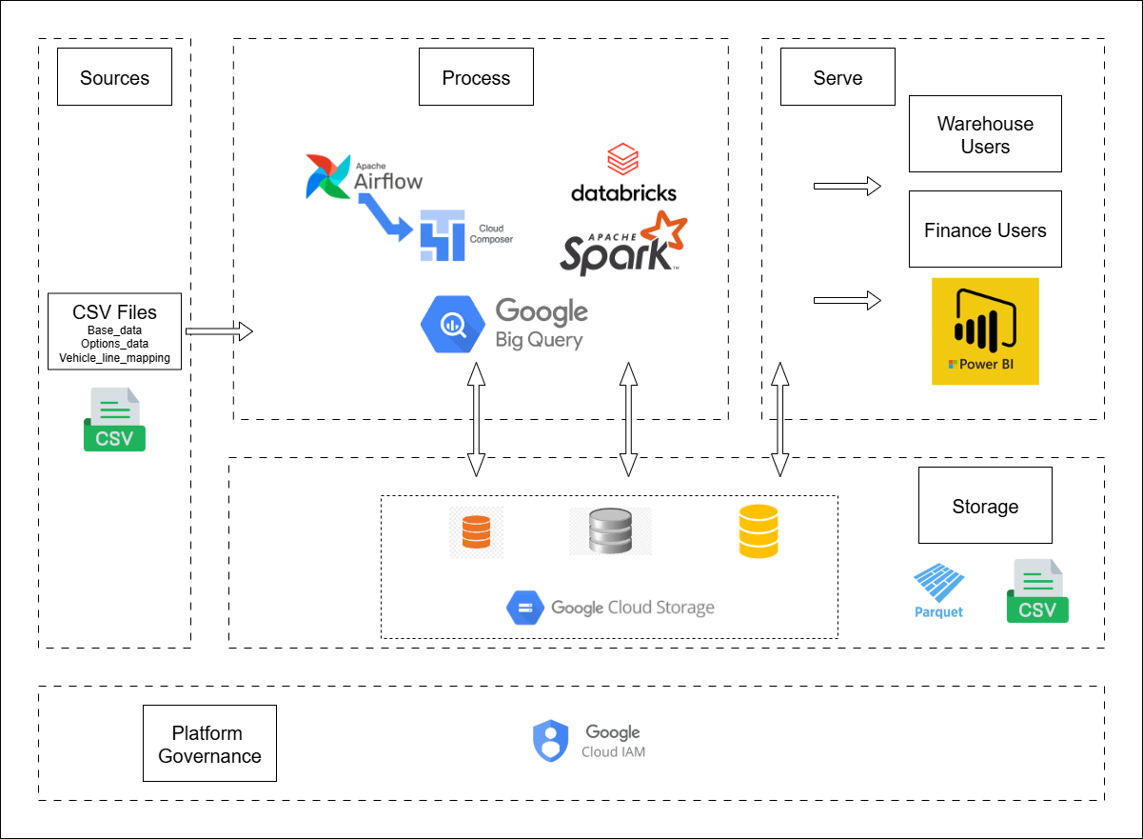
Pipeline/System Architecture

Slide 8
First Stage – Data Ingestion & EDA
Raw Landing: Source files landed in Google Cloud Storage (Raw Layer).
Schema Creation: SQL queries defined schema → loaded into BigQuery external tables, then into raw BigQuery tables.
Exploration in Databricks (PySpark):
Removed duplicate rows.
Filled missing values with ‘Unknown’ (categorical only).
Aggregated base data to calculate net sales & net quantity.
Dropped redundant columns (sales price, option quantities).
Outcome :
Data cleaned, structured, and optimized for downstream enrichment.
Established consistent, high-quality foundation across all datasets.

Slide 9
Second Stage – Data Transformation & Enrichment
Load Transformed Data :
Parquet files read into transformed.external → transformed tables in BigQuery.
Data then consumed by PySpark notebooks for enrichment.
Enrichment Steps :
Join with Options Data :- material cost matched to base data on (option code, model).
Fallback: Average Material Cost :- Computed average cost per option code and joined to base data.
Join with Vehicle Line Mapping :- Align option data to correct vehicle models.
Apply Enrichment Logic :- Production cost derived using 4-step precedence rules, enabling profit calculation.
Outcome :
Base sales data enriched with production cost.
Reliable profit per option per VIN dataset produced, ready for downstream reporting & analytics.

Slide 10
Third Stage – Data Curation & Reporting
Load Enriched Data :
Enriched Parquet files → external transformed enriched tables → transformed enriched tables.
Final Calculations :
Profit per transaction derived (net sales price – production cost).
Dataset written to Parquet (Curated Layer).
Curated Layer in BigQuery :
Parquet → external curated table → curated table.
Reporting & Insights :
Curated tables consumed in Power BI dashboards.
Delivered total profit across all options and additional insights (e.g., profitable vs non-profitable options, anomalies, distribution).
Outcome
Fully curated dataset powering business-ready Power BI dashboards.
JLR stakeholders can now trust profit metrics and make option-level profitability decisions.

Slide 11
Necessary IAM Permissions
BigQuery & GCS
RAW/ datasets → ETL = dataEditor
TRANSFORMED/CURATED datasets → ETL = dataEditor; Analysts = dataViewer
GCS → uniform bucket-level access; prefix-scoped objectViewer (RAW), objectCreator (SILVER/GOLD
Cloud Composer
composer.user
Worker SA → iam.serviceAccountUser on Pipeline Runner SA
Pipeline Runner SA
BigQuery → bigquery.jobUser (project) + dataset dataEditor / dataViewer
GCS → storage.objectViewer (read), storage.objectCreator / objectAdmin (write, prefix-scoped)
Secrets → secretmanager.secretAccessor

Slide 12
Cloud System Setup – Issues & Fixes
GCS & BigQuery Permissions
Issue: Overly broad access caused failures and risk.
Fix: Applied prefix-scoped GCS IAM Conditions + dataset-level BQ grants → least privilege with successful access.
Airflow / DAG Execution
Issue: Broken DAG errors (BigQueryInsertJobOperator missing configuration).
Fix: Corrected operator config, validated with test runs in Composer.
Databricks Notebook Execution
Issue: Python file not found (dbfs:/FileStore/...).
Fix: Converted .py files to notebooks, ensured proper workspace file paths & job configs.

Slide 13
Potential Future Upgrades & Optimizations
Data Pipeline Improvements
Add incremental processing instead of full refresh → faster + cost-efficient.
Data Quality & Testing
Expand Great Expectations suite with anomaly detection.
Automate regression testing in CI/CD before deployment.
Scalability & Performance
Optimize Spark jobs with adaptive execution & partition tuning.
Use Iceberg/Delta tables for time-travel and schema evolution.
Security & Governance
Apply row/column-level security in BigQuery for sensitive data.
Analytics & Business Impact
Build self-service dashboards for profitability by option/region.
Integrate ML models to predict production costs for new options.

Slide 14

Thank you!

